Slide 1

Google Recaptcha
without the install

Slide 2
Open the Google Chrome and type the
Link :- https://www.google.com/recaptcha/admin/create

Slide 3
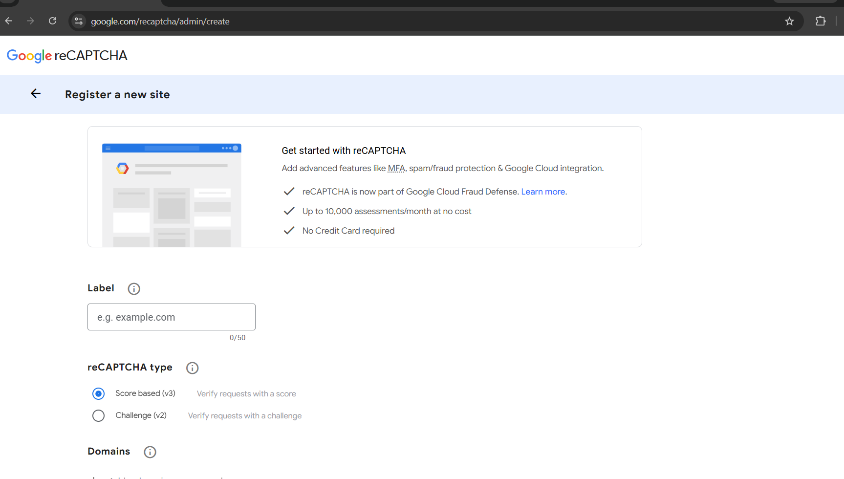

Slide 4
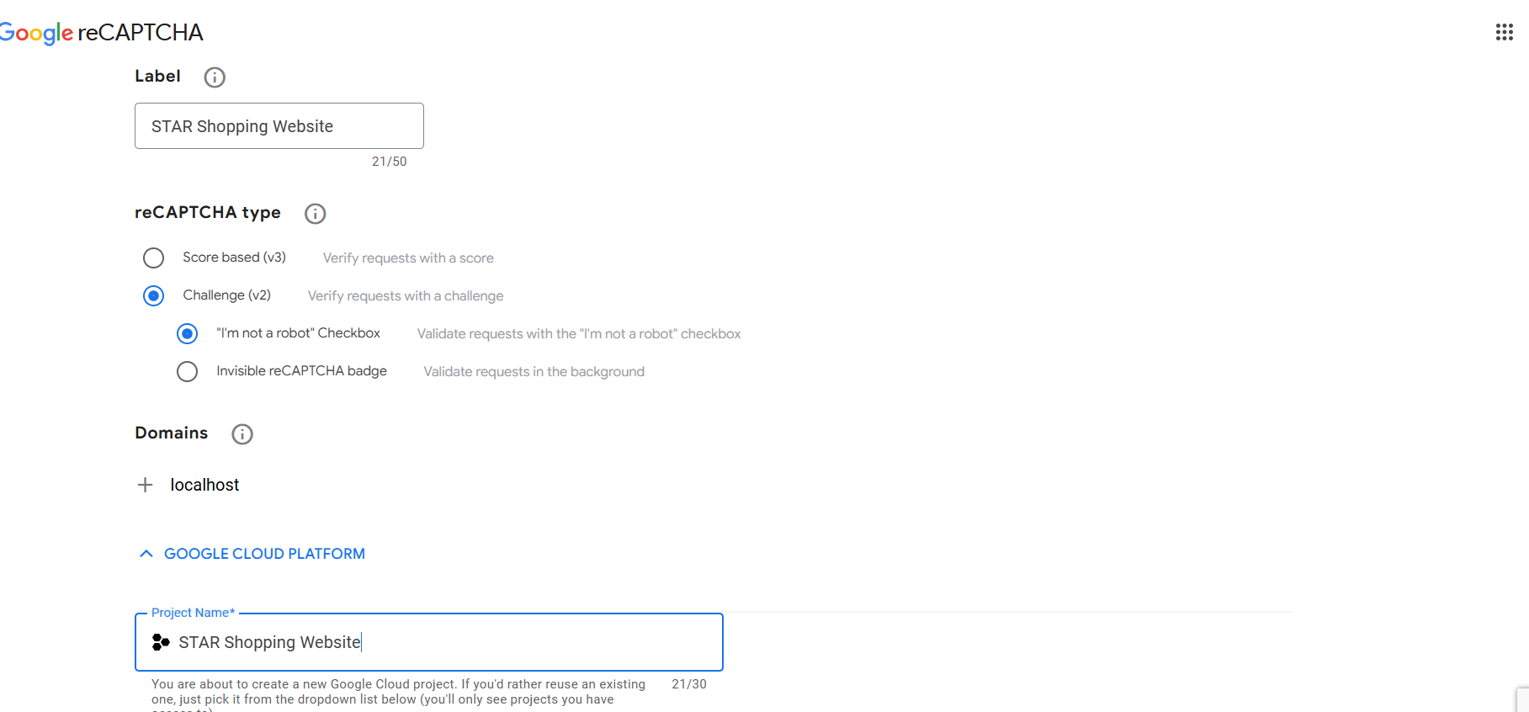

Slide 5
